Slide 1

Blockchain-Cloud File Sharing: Secure and Decentralized Data Management
This presentation outlines a novel approach. We will explore secure, decentralized file sharing. The approach combines blockchain and cloud technologies. Discover how this system addresses vulnerabilities. It also enhances data management efficiency.

Slide 2
Centralized Storage: Vulnerabilities & Inefficiencies
Single Point of Failure
Lack of Transparency
Data Silos
Centralized systems are vulnerable. A single breach can compromise all data.
Users often lack visibility. Data access and modifications are opaque.
Information is often isolated. It is trapped, hindering collaboration and insights.

Slide 3

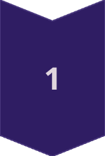
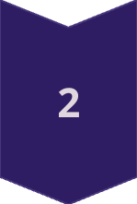
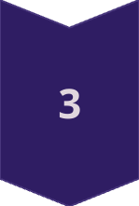
Our Solution: Hybrid Architecture
Blockchain Layer
Handles access control. It also handles data integrity via immutable records.
Cloud Storage
Provides scalable, cost-effective storage. It ensures availability and redundancy.
API Integration
Enables seamless interaction. It interacts between blockchain and cloud components.

Slide 4



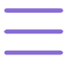
Key Features
Enhanced Security
Transparency
Auditability
All data transactions are recorded. The transactions are recorded on an immutable ledger.
Comprehensive audit trails ensure compliance. Track all data modifications.
Blockchain encryption ensures data protection. Only authorized parties can access files.

Slide 5

Real-World Use Cases
Healthcare
Supply Chain
Securely share patient records. Maintain compliance with privacy regulations.
Track goods and verify authenticity. Reduce fraud and improve transparency.
Intellectual Property
Protect copyrights and patents. Securely share sensitive documents.

Slide 6

Future Directions and Implementation Roadmap
1
Scalability Enhancements
2
Interoperability
Support multiple blockchains. Enable seamless data exchange.
Implement sharding. Explore layer-2 solutions for increased throughput.
3
AI Integration
Utilize AI. Automate threat detection and improve data governance.

